Slide 1
simply Typed lambda Calculus
Simply Typed Coq Lambda Calculus
Presented by CS 550 Group 3

Slide 2
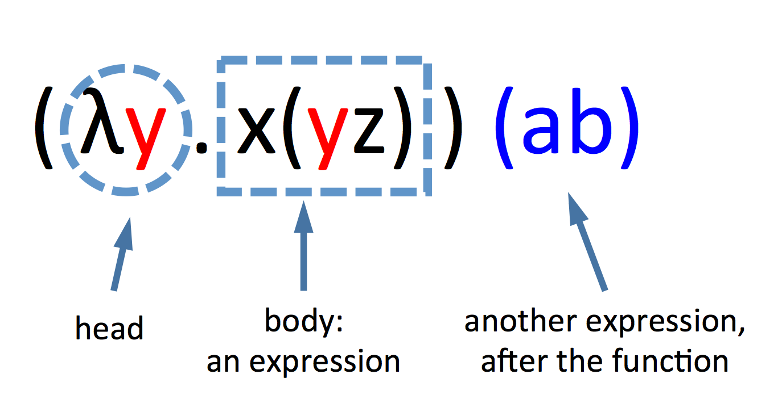
What is STLC?
Lambda calculus with one type constructor
“→” builds function types
Tiny core calculus embodying functional abstraction
Built on a collection of base types—i.e.
Booleans
Numbers
Strings
Exact choice of types is trivial
Language of higher-order functions
Functions that can take other function as arguments and/or return other functions

Slide 3
Syntax of STLC

Slide 4

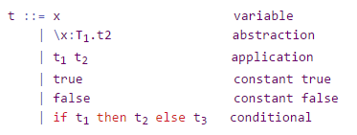
Syntax
λx(type).t2 →
“x” is the parameter
“t2” is the body
“T1” specifies the types of arguments that the function can be applied to
BNF notation of abstract syntax

Slide 5
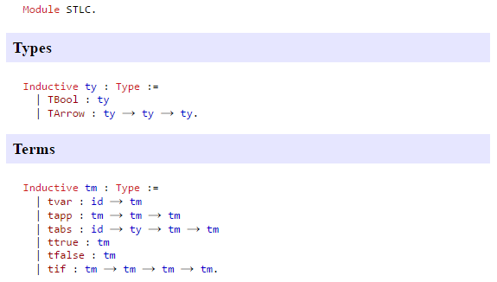
Syntax
Formalizing syntax of STLC in Coq
Types
TBool: Boolean constants true and false
TArrow: More complex computations that can yield Booleans and classify functions
Terms
tvar: variable
tapp: application
tabs: abstraction
ttrue: constant true
tfalse: constant false
tif: if statement

Slide 6
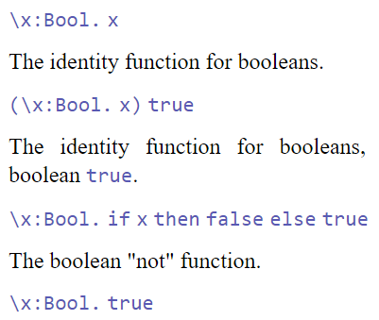
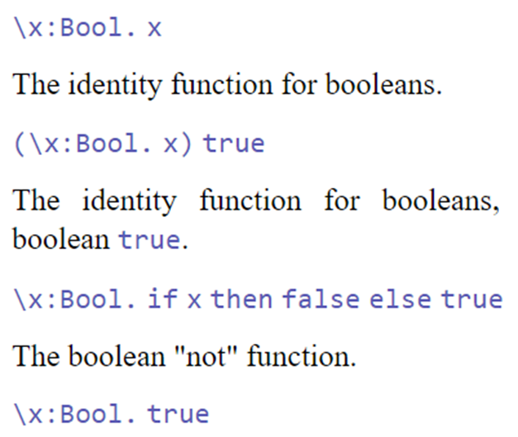
Syntax Examples
Boolean expressions
Literal Meanings
Identity: returns any Boolean value passed into function
True applied to identity function: returns true
“Not” function: returns opposite of Boolean passed into function
Returns true for any Boolean passed into function

Slide 7
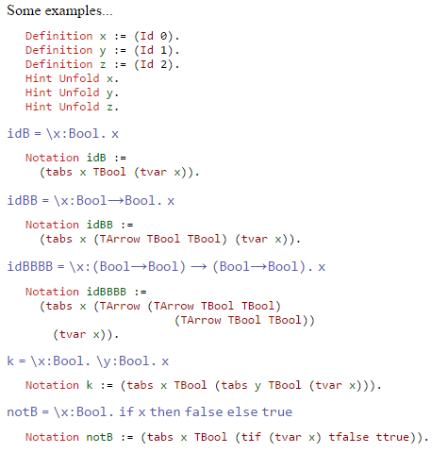
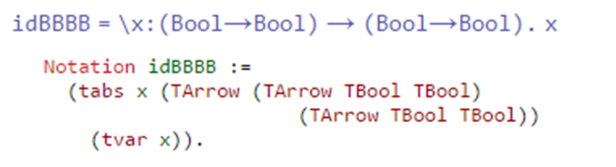
Syntax
Examples
Identity function from earlier that takes Boolean and returns it
Function that takes function as input and returns it
Function that takes idBB as an input and returns it

Slide 8
Operational Semantics

Slide 9
Values
Cases
Booleans
true and false
Application
Not a value
Function being invoked
Abstractions: Two choices
\x:T.t1 is a value only if t1 is a value
Declare \x:T.t1 a value
Reduction stops at abstractions
Complete program
No undefined variables
No free variables

Slide 10

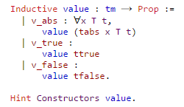
Values
Gallina, Coq’s built-in language uses first choice
This assures that a value is ultimately reached and never-ending recursion can be avoided
Most real-world functional languages make second choice
Most languages aren’t also a consistent logic, thus establishing an end value isn’t required

Slide 11
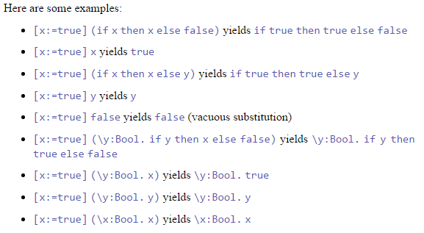

Substitution
Heart of STLC
Substitute one term for a variable in another term
“substitute x with s in t”
With \x.Bool.x , substituting x with true does not yield true
VERY IMPORTANT
x within the body is bound by the abstraction
Global variable is changed with same name as local variable

Slide 12
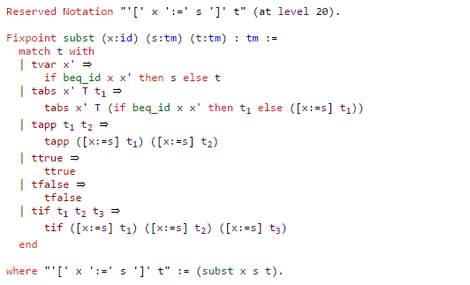
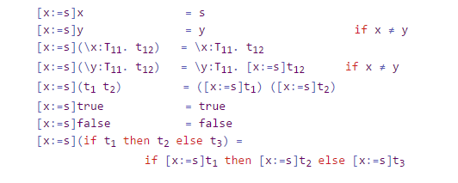
Substitution
Formal Definition
Informal Definition

Slide 13
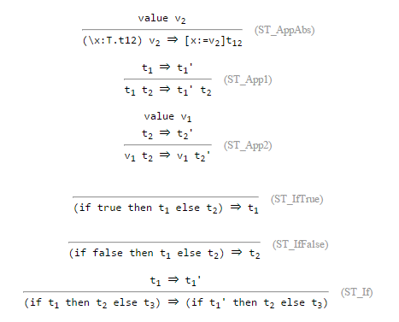

Reduction
Begin reducing function (left-side) to abstraction
Then reduce argument (right-side) to value
β-reduction

Slide 14
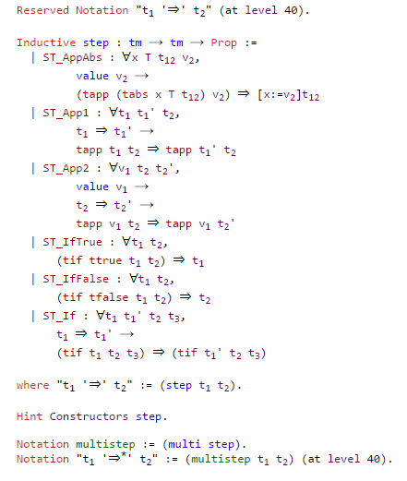
Reduction
Formal definition for reduction
ST_AppAbs: application and abstraction
ST_App1: application first term
ST_App2: application second term
ST_IfTrue: true conditional statement
ST_IfFalse: false conditional statement
ST_If: conditional statement

Slide 15
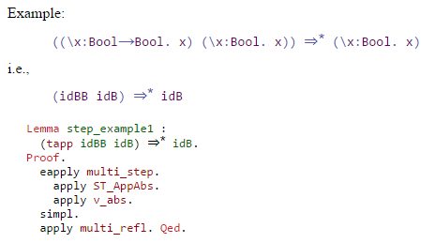
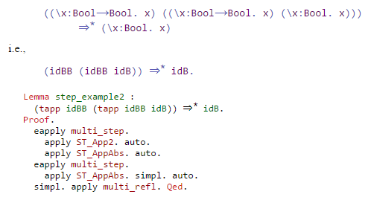
Reduction
Example Proof 1:
Example Proof 2:

Slide 16



Reduction
Alternatively, custom “normalize” tactic can be used to simplify process
Simplifies Example Proof 1 & 2

Slide 17
STLC Type System

Slide 18
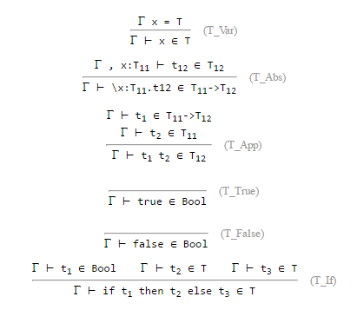
Typing
Type of term depends on types of its free variables
E.g. Type of “x y” depends on types of x and y
Requires three-place typing judgment
“Γ ⊢ t ∈ T”
“to the term t we can assign the type T using as types for the free variables of t the ones specified in the context of Γ”

Slide 19
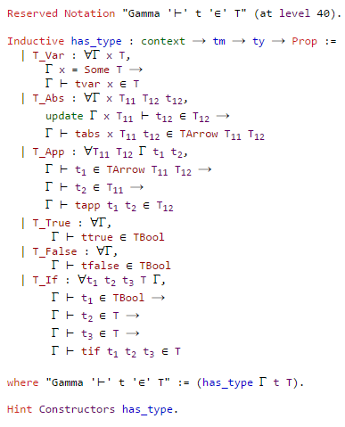
Typing
Formal definition of operational semantics on previous slide
T_Var: x in a given context
T_Abs: abstraction
T_App: application
T_True: ttrue is Boolean in all contexts
T_False: tfalse is Boolean in all contexts
T_If: if-else statement

Slide 20
Properties and Extensions of STLC

Slide 21
Preservation
Preservation theorem
Proved by induction on type derivation
Substitution lemma
Substitution preserves types
Context invariance lemma
Inessential changes to context (that do not affect free variables) preserve types
Free variables of a term
Actually free variables?
Progress and Preservation are essential for maintaining the soundness of the STLC

Slide 22

Progress
Closed well-typed terms are not stuck
The well typed term is either…
A value
Can be further reduced
In programming, a program is either a defined value or can step into another program

Slide 23
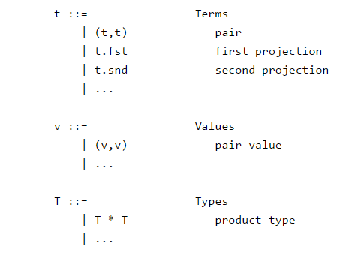
STLC Extensions
Example (Pairs)
Syntax
Numbers
Pairs
Unit
List
Sums
Recursion
Records

Slide 24
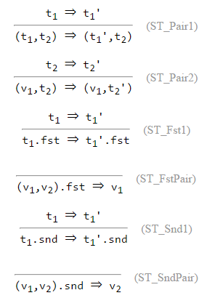
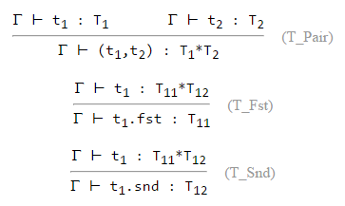
STLC Extensions
Example (Pairs) cont.
Reduction Rules
Typing Rules

Slide 25
Questions?

Slide 26
Thank You
CS 550 Group 3
Ankush Israney
Michael Dodds
Jaidev Ramakrishna

